Slide 1

AZERBAİJAN STATE OİL AND İNDUSTRY UNİVERSİTY
Name: Məmmədzadə Hüseyn
Group: 682.24E
Subject: ITPM
Faculty: Information Technologies
Presentation Topic: Cost Estimation and Budgeting
Notes:
1

Slide 2
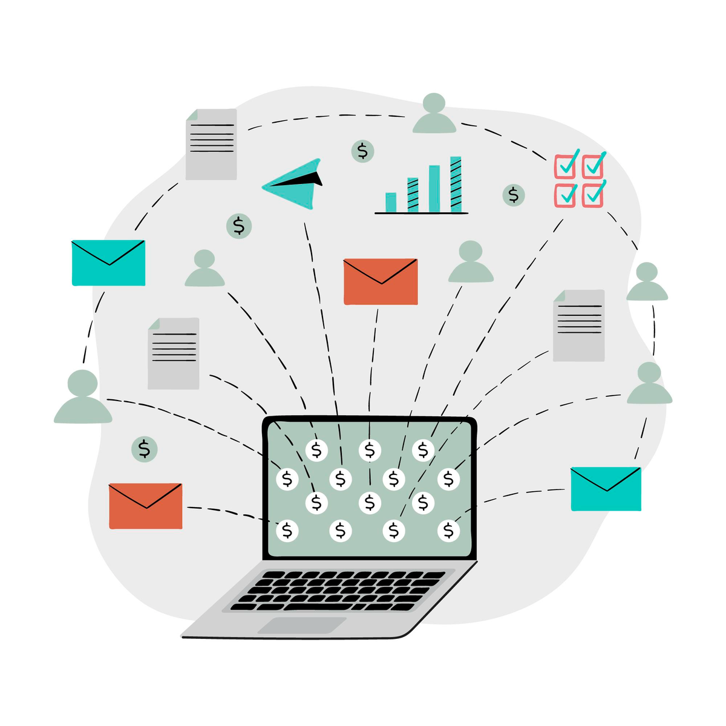
Navigating the Financial Architecture of IT Projects
In IT, estimating costs is about deciding if a project is even worth doing. Since software and data aren't physical things you can hold, getting the budget right is tricky but super important.
We cover how to turn uncertain ideas into a solid budget so your project actually succeeds without running out of cash. We’ll look at the best tools and methods to manage your spending from the first day until the project is finished.
Notes:
1

Slide 3

Presentation Plan
1. Introduction to Cost Estimation and Budgeting in IT
2. Presentation Plan
3. The Core Pillars of IT Cost Estimation
4. Methodologies: From Top-Down to Bottom-Up
5. Advanced Estimation: Parametric and Three-Point Modeling
6. The Role of WBS in Financial Accuracy
7. Real Example 1
8. Budgeting: Developing the Financial Baseline
9. Managing the Unknown: Contingency and Management Reserves
10. Cost Control and Earned Value Management (EVM)
11. Real Example 2
12. Overcoming Psychological Bias and "Scope Creep"
13. Strategic Best Practices for ITPM Success
14. Conclusion and Summary
Notes:
2

Slide 4




The Core Pillars of IT Cost Estimation
Good IT estimation relies on People, Process, and Technology.
People are your biggest expense, including developers and security experts. You also need to budget for cloud services, hardware, licenses, and the cost of fixing old code. Mastering these areas turns random guesses into accurate, data-driven budgets.
People
Process
Specialized labor of developers, architects, and security experts
Infrastructure, cloud services, and hardware requirements
Technology
Software licensing and hidden costs of technical debt
Notes:
3

Slide 5
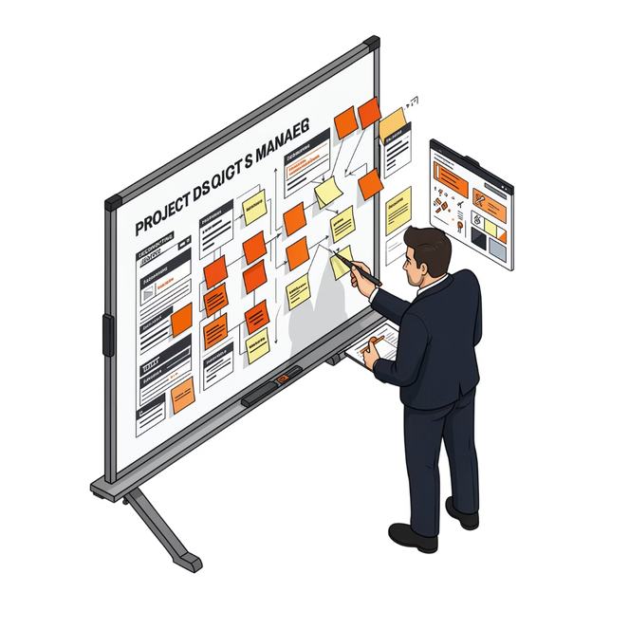
Methodologies: From Top-Down to Bottom-Up
Choosing the right approach depends on the project's current phase.
Top-Down Estimating
Bottom-Up Estimating
Used during the early discovery phase. It relies on historical data from previous IT projects to provide a high-level figure.
This is the gold standard for accuracy. Here, the project is decomposed into the smallest possible tasks. By estimating the cost of each individual component, such as API integration or UI design, and rolling them up, we create a granular and defensible budget.
Notes:
4

Slide 6

Advanced Estimation: Parametric and Three-Point Modeling
To account for uncertainty, IT managers use mathematical models.
Parametric Estimating
Three-Point Estimating
Uses statistical relationships between historical data and variables (e.g., cost per lines of code or cost per database schema).
Instead of a single number, we calculate a weighted average to account for risk. Using the PERT (Program Evaluation and Review Technique) formula:
Where O is the Optimistic cost, M is the Most Likely, and P is the Pessimistic. This ensures the IT budget isn't built on a "best-case scenario" that rarely happens.
Notes:
5

Slide 7

The Role of WBS in Financial Accuracy
The Work Breakdown Structure (WBS) is the bridge between project scope and the budget. In IT, the WBS breaks down complex deliverables (like a mobile app) into manageable work packages (like user authentication or payment gateway integration). Without a comprehensive WBS, items like system testing, documentation, and security audits are often forgotten, leading to significant budget overruns. Every line item in your budget should correspond to a specific point in your WBS.
Work Packages
Auth, Payments, Testing, Docs, Security
Mobile App
Top-level deliverable for the project
Notes:
6

Slide 8
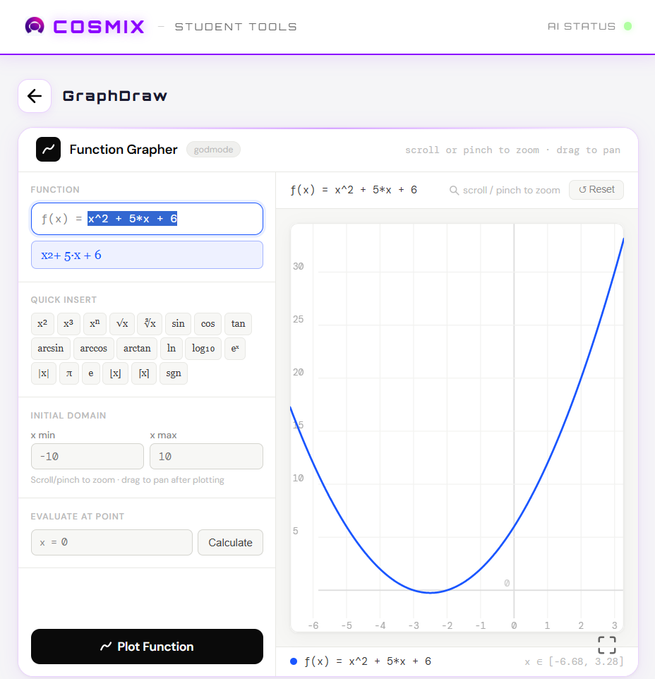
Real Example - Cosmix Project
For the Cosmix - Student Tools project, we chose to build mostly on the client-side to keep costs at zero while maintaining high speed.
This decision paid off. The app is fast, easy to manage, and costs nothing to run. Because it is cached, each user essentially sends just one request to the Vercel hosting servers, and the rest runs locally on their device.
Why This Worked
Zero Hosting Costs: By offloading the work to the user's browser (client-side), we don't need expensive backend servers to process data.
Vercel + Caching: Vercel serves the static files once, and the browser handles the rest. This minimizes server hits and keeps us within free-tier limits.
Performance: Since the logic lives on the user's side, there’s no "waiting for the server" after the initial load. It feels instant.
Notes:
7

Slide 9
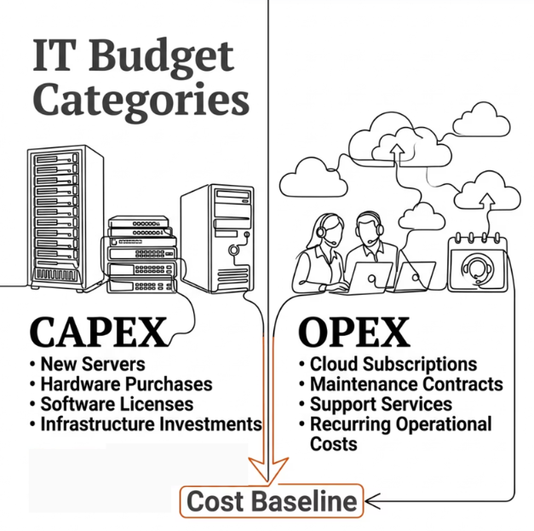
Budgeting: Developing the Financial Baseline
Budgeting is the process of creating estimated cost and attach it to a timeline. In IT, this includes distinguishing between CAPEX (Capital Expenditures like new servers) and OPEX (Operating Expenses like cloud subscriptions). The result is the Cost Baseline-a time-phased budget that the project manager uses to measure and monitor cost performance. This baseline is critical for stakeholders to understand when cash outflows will occur during the development lifecycle.
CAPEX
OPEX
Capital Expenditures — new servers, hardware, infrastructure investments
Operating Expenses — cloud subscriptions, maintenance, support services
Cost Baseline
Time-phased budget used to measure and monitor cost performance throughout the project
Notes:
8

Slide 10

Managing the Unknown: Contingency and Management Reserves
IT projects are notorious for "unknown unknowns." To protect the project, two types of buffers are used:
Contingency Reserves
Management Reserves
These are funds allocated for "known risks" (e.g., a vendor might delay a software delivery). These are part of the cost baseline.
These are for unforeseen changes in scope or major external shifts. Properly managing these reserves ensures that when a technical hurdle appears, the project doesn't stall due to a lack of immediate funding.
Notes:
9

Slide 11

Cost Control and Earned Value Management (EVM)
Tracking spend is not enough; you must track value. Earned Value Management (EVM) is a powerful IT metric that integrates scope, time, and cost.
Cost Performance Index (CPI)
Planned Value (PV)
Actual Cost (AC)
By calculating the Cost Performance Index (CPI), an IT manager can tell instantly if the project is over or under budget relative to the work performed.
What we intended to spend
What we have actually spent
Earned Value (EV)
The value of the work actually completed
A CPI below 1.0 means the project is over budget. A CPI above 1.0 means the project is under budget.
Notes:
10

Slide 12
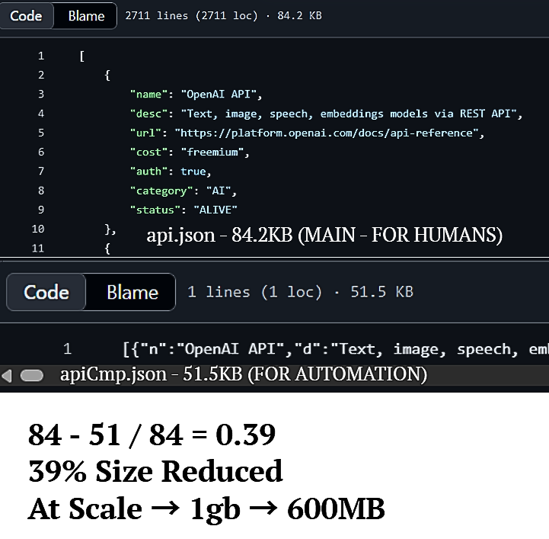
Real Example - API Listing Json
To reduce costs in my API Listing project, I optimized the data structure by creating a minified version called apiCmp.json.
I achieved a 39% reduction in file size through two main methods:
Key Mapping: I replaced long property names like name, desc, and url with single-letter keys (n, d, u).
Minification: I removed all whitespace and indentation.
This optimization significantly lowers bandwidth usage and speeds up load times while keeping the project cost-effective.
Cost Impact: Vercel and other providers charge based on bandwidth, this ensures the project stays well within the free-tier limits even with high traffic.
Notes:
7

Slide 13

Overcoming Psychological Bias and "Getting Things Done"
Budgeting fails because people are naturally too optimistic. We often think coding will be faster than it is (Optimism Bias) and keep wasting money on bad ideas just because we’ve already spent a lot (Sunk Cost Fallacy).
To fix this, use these simple rules:
Track Everything: Record every single expense, no matter how small.
Define "Done": Be clear about when a feature is finished so you don't waste time adding unnecessary extras.
Check Often: Regularly compare your spending to your actual progress to make sure your next steps still make sense financially.
Notes:
2

Slide 14

Strategic Best Practices for ITPM Success
To ensure financial health in IT projects:
Involve the Technical Team: Never estimate in a vacuum; the people writing the code should have a voice in the cost.
Iterative Refinement: Re-estimate at the start of each sprint or phase as requirements become clearer.
Standardize Tools: Use consistent software for tracking to avoid data silos.
Communicate Early: If a budget overrun is predicted, inform stakeholders immediately with data-backed solutions.
Notes:
2

Slide 15

Conclusion and Summary
Thank you for your time and engagement. Managing the finances of IT projects is a complex but rewarding challenge that requires both technical insight and administrative discipline. We are now open for any questions regarding the methodologies discussed or the real-world applications of these budgeting strategies.
Notes:
2

